Slide 1
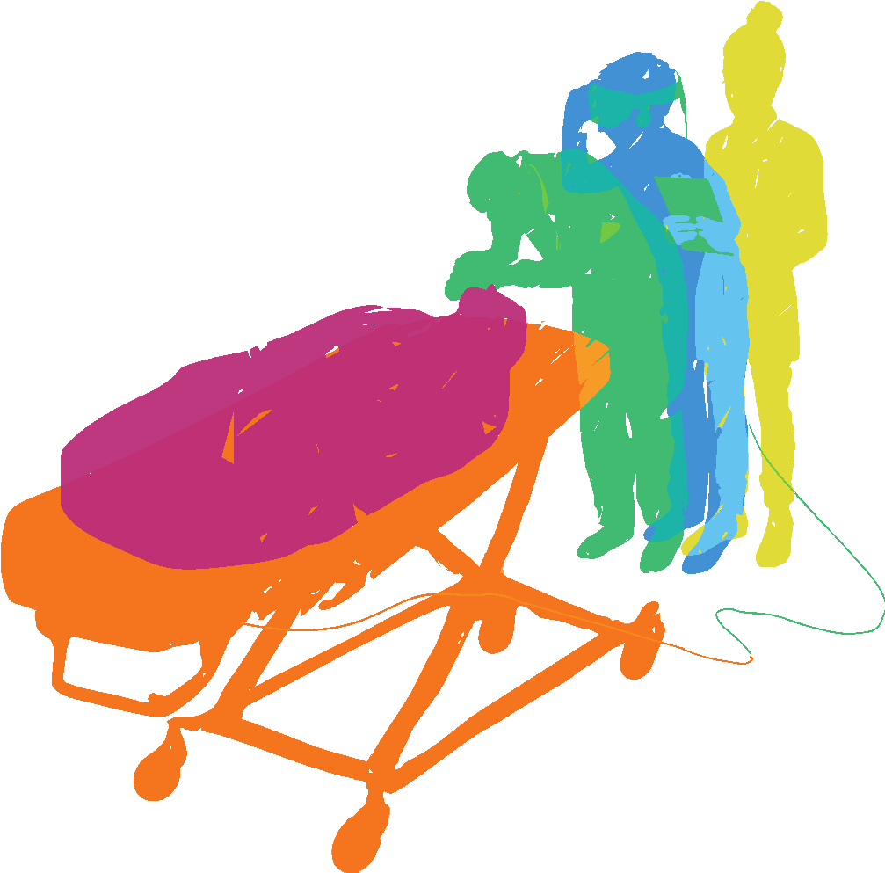
ORGANIZATION
Bringing Processes to Your Center
SIMULATION:
BRINGING LEARNING TO LIFE
#IMSH2021
Notes:
Faculty Introductions and Disclosures - Cynthia (5 minutes)

Slide 2
Welcome!
Devin Stine, CHSOS
Brian Hanlon, BS, CHSOS
Kati Maxkenzie, MSHS, CHSOS, CHSE
Lauren O’Niell, BFA
Cynthia Shum, DNP, MEd, RN, CHSE-A
SIMULATION: BRINGING LEARNING TO LIFE
#IMSH2021

Slide 3
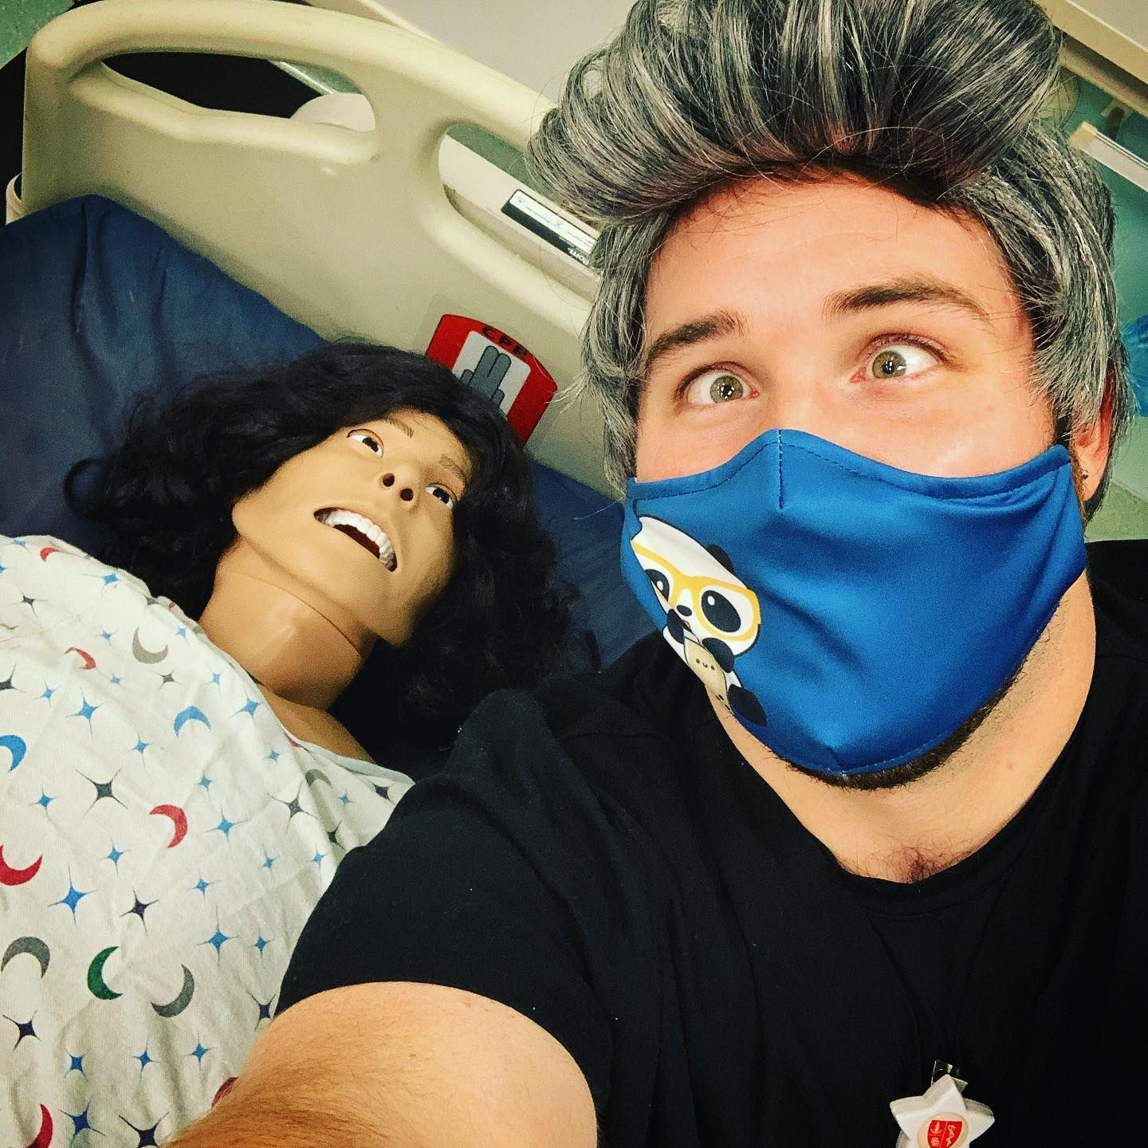
WELCOME
Devin Stine
CHSOS / Devin is a Simulation Specialist at Stanford University’s Center for Immersive and Simulation-based Learning in Stanford, CA . He has over two and a half years of experience in healthcare simulation, and his background includes working in healthcare, theatre, military, and more. He is always looking for ways to improve processes at his center and to help others in the simulation community as well.
SIMULATION:
BRINGING LEARNING TO LIFE
#IMSH2021

Slide 4
WELCOME
Brian Hanlon
BS, CHSOS / Brian is the Simulation Center Operations Specialists for Alameda Health System at Highland Hospital in Oakland Ca, Brian has over 6 years of experience in Healthcare Simulation with a background in video production. Brian specializes in creating realistic moulage and trauma simulation for his institution.
SIMULATION:
BRINGING LEARNING TO LIFE
#IMSH2021

Slide 5
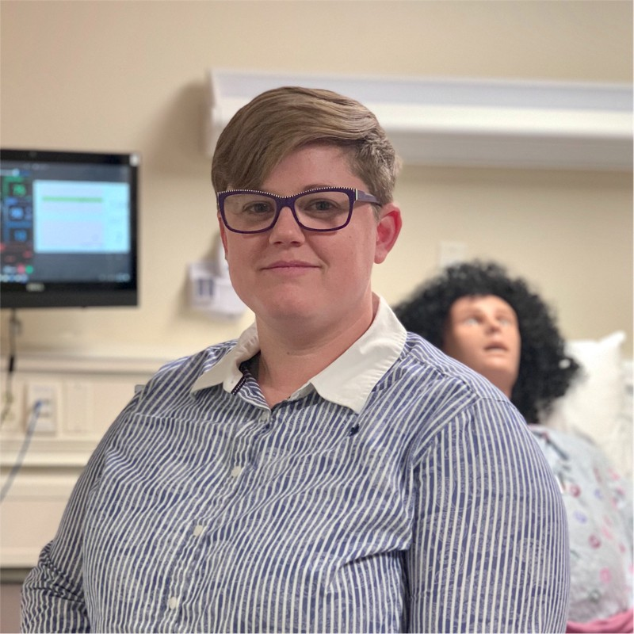
WELCOME
Kati Maxkenzie
MSHS, CHSOS, CHSE / Kati is the Simulation Center Manager at Alameda Health System in Oakland, CA. She has over 6 years experience in Healthcare Simulation Operations. She has a background in theatre and business management. Kati has her Masters in Healthcare Simulation, is dual certified by the Society for Simulation in Healthcare, and has presented at local, national, and international conferences on multiple topics about simulation operations.
SIMULATION:
BRINGING LEARNING TO LIFE
#IMSH2021

Slide 6
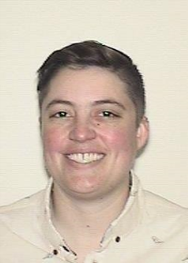
WELCOME
Lauren O’Niell
BFA / Lauren is a Simulation Operations Specialist at Samuel Merritt University in Oakland, CA. They enjoy a fast paced work environment that fosters continuous learning opportunities, creative problem solving, and space to create streamlined processes. Outside of work, you are equally likely to find them nose deep in a good book or running lights and sound for a local theater company.
SIMULATION:
BRINGING LEARNING TO LIFE
#IMSH2021

Slide 7
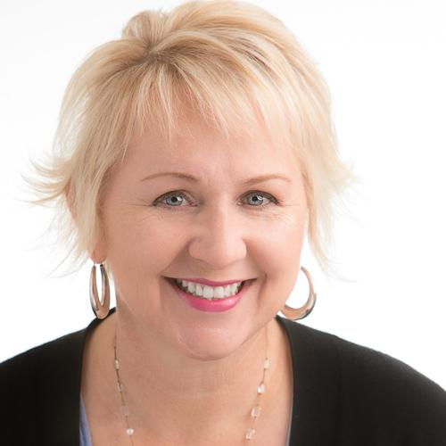
WELCOME
Cynthia Shum
DNP, MEd, RN, CHSE-A
Cynthia has worked in the field of healthcare simulation for 11 years. She is the Director of Professional Development and Clinical Education at Stanford Children’s Hospital where she oversees Nursing education including the Simulation Center. Prior to this she was the Director of Education and Operations at the VA Palo Alto Simulation Center Hospital for 9 years.
Dr. Shum is faculty with the California Simulation Alliance. She is the Chair of the Media and Communications Committee with SSH. Disclosures: Cynthia is an independent consultant for HealthImpact, the home of the California Simulation Alliance (CSA)
SIMULATION:
BRINGING LEARNING TO LIFE
#IMSH2021

Slide 8
LEARNING OBJECTIVES
Explain how an organization system will improve the efficiency of their simulation program
Determine the type of organization system for their program’s various needs
Evaluate the effectiveness of implementing a complete system to organize their center
SIMULATION:
BRINGING LEARNING TO LIFE
#IMSH2021

Slide 9
Creating and managing a complete system to organize all the ‘stuff’ in your simulation center can be a challenge. This panel will lead a discussion on various methods used for organizing everything from equipment and supplies to scheduling and project tracking. You will discover simple tools many of which are free which will improve the efficiency of your program.
Bring us your Organization challenges!
SIMULATION: BRINGING LEARNING TO LIFE
#IMSH2021

Slide 10
Organization
What is organization?
” the act of organizing something.”
“ It can also refer to a system of arrangement or order, or a structure for classifying things.”
- Google
“ I have all this stuff, what do I do with it ”
- Simulation Operations Specialist(s)
- Sim Tech(s)
- Educators/Facilitators
- Simterns
- Insert Sim Title Here
SIMULATION: BRINGING LEARNING TO LIFE
#IMSH2021
Notes:
Brian

Slide 11
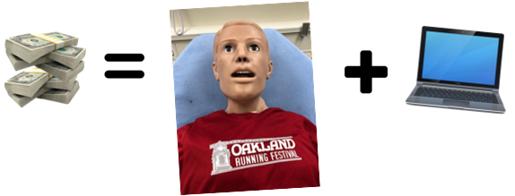
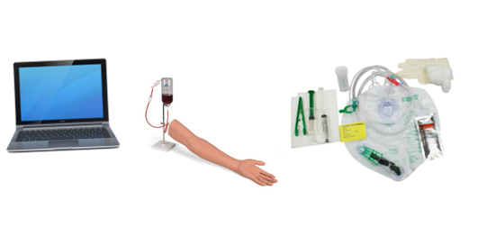
Organization
Capital vs Consumable, Supply Inventory
Capital Inventory: $5,000 – $$$$$$$
- Institutional Approval - Committee
General Supply / Consumables: < 5,000
Electronic(s)/Task Trainers/Medical Supplies
Department Approval – Whats in the budget?
SIMULATION: BRINGING LEARNING TO LIFE
#IMSH2021
Notes:
Brian

Slide 12
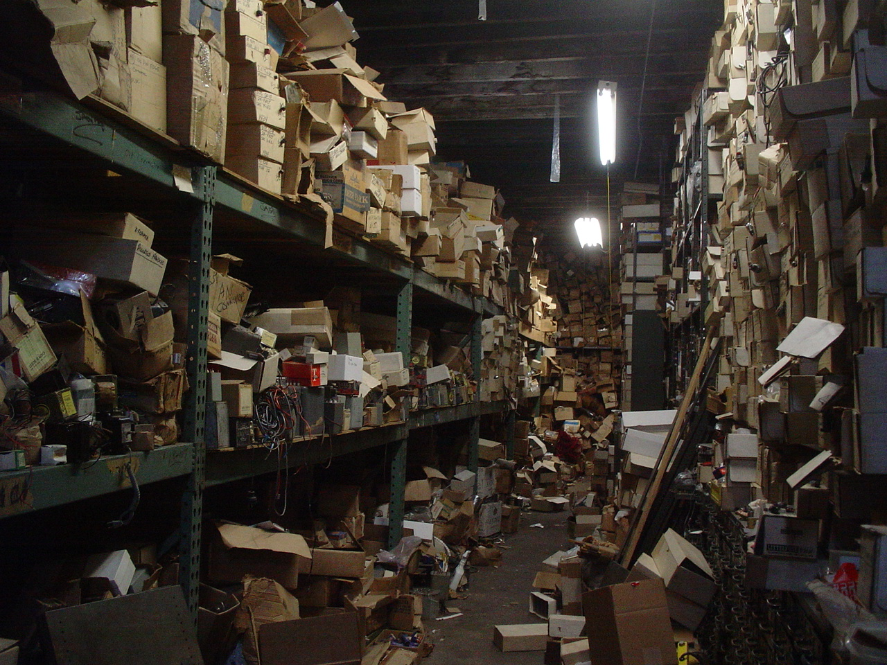
SIMULATION: BRINGING LEARNING TO LIFE
#IMSH2021
Notes:
10 minutes total
Why?
Why do we need organization?
Efficiency; tracking; security; availability
Each of us takes 2 minutes to explain why we need organization

Slide 13
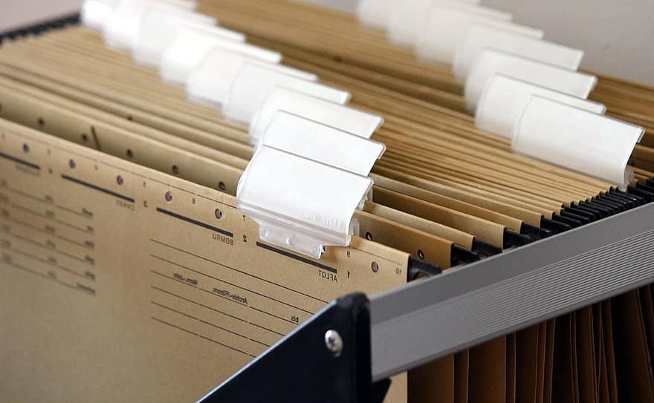
How do we organize?
Information
Hard/Paper
Coursework, forms, files
File folders/organizers
Storage
Soft/Electronic
Scanned copies
Electronic forms and files
System for managing data
SIMULATION: BRINGING LEARNING TO LIFE
#IMSH2021
Notes:
10 minutes - Devin
How?
Electronic, records, database
Cognitive aids
Physical, supplies

Slide 14
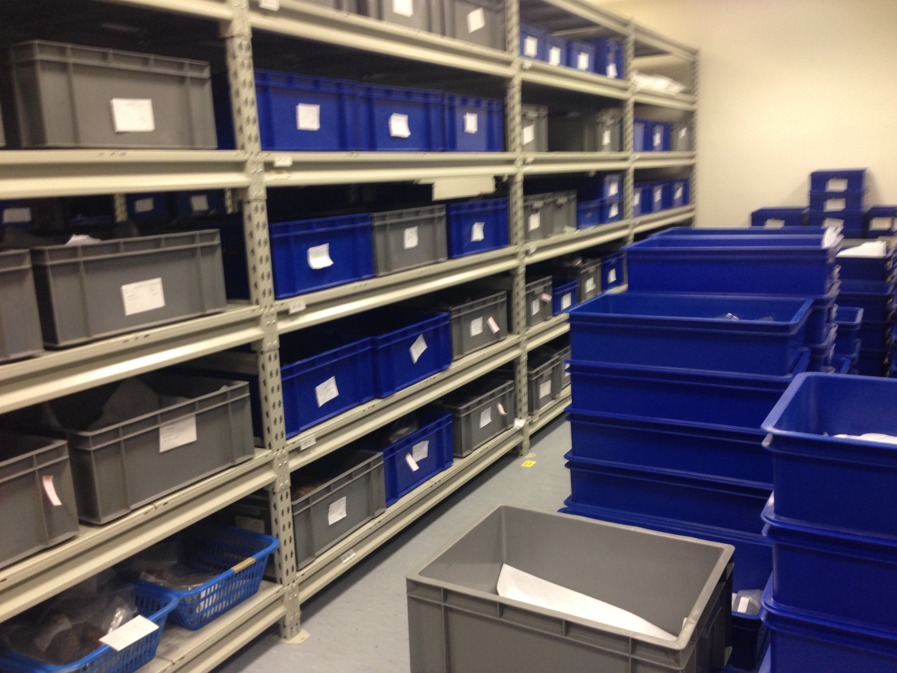
How do we organize?
Equipment and Supplies
Location and Storage
Find available space
Grouping of items
Special requirements
Labeling and Tracking
Helps to identify and locate
Reorder and repair
Track info, location, use
SIMULATION: BRINGING LEARNING TO LIFE
#IMSH2021
Notes:
10 minutes - Devin
How?
Electronic, records, database
Cognitive aids
Physical, supplies

Slide 15
How do we organize?
Cognitive Aids
Information
How to manage data in center
Processes for paper/electronic
Equipment and Supplies
Procurement, storage, tracking
Intake and excess
Operations
Frequent and infrequent
Training/onboarding
SIMULATION: BRINGING LEARNING TO LIFE
#IMSH2021
Notes:
10 minutes - Devin
How?
Electronic, records, database
Cognitive aids
Physical, supplies

Slide 16
How do create organization through process?
LEAN Methodology - PDCA Cycle
Plan
Do
Check (or Study)
Act
Instructional Design - ADDIE Model
Analyze
Design
Development
Implementation
Evaluation
SIMULATION: BRINGING LEARNING TO LIFE
#IMSH2021
Notes:
Kati - 10
How?
Processes, communication
Scheduling, capacities, changes
COVID process updates
Branson, R. K., Rayner, G. T., Cox, J. L., Furman, J. P., King, F. J., Hannum, W. H. (1975). Interservice procedures for instructional systems development. (5 vols.) (TRADOC Pam 350-30 NAVEDTRA 106A). Ft. Monroe, VA: U.S. Army Training and Doctrine Command, August 1975. (NTIS No. ADA 019 486 through ADA 019 490).
Moen, Ronald; Norman, Clifford. "Evolution of the PDCA cycle" (PDF). westga.edu. Paper delivered to the Asian Network for Quality Conference in Tokyo on September 17, 2009. Retrieved 1 October 2011.

Slide 17
How do create organization through process?
Scheduling
Faculty & Learner Communication
Capacities
Curriculum Changes
SIMULATION: BRINGING LEARNING TO LIFE
#IMSH2021
Notes:
Kati - 10
How?
Processes, communication
Scheduling, capacities, changes
COVID process updates
Branson, R. K., Rayner, G. T., Cox, J. L., Furman, J. P., King, F. J., Hannum, W. H. (1975). Interservice procedures for instructional systems development. (5 vols.) (TRADOC Pam 350-30 NAVEDTRA 106A). Ft. Monroe, VA: U.S. Army Training and Doctrine Command, August 1975. (NTIS No. ADA 019 486 through ADA 019 490).
Moen, Ronald; Norman, Clifford. "Evolution of the PDCA cycle" (PDF). westga.edu. Paper delivered to the Asian Network for Quality Conference in Tokyo on September 17, 2009. Retrieved 1 October 2011.

Slide 18
How do create organization through process?
COVID-19 Challenges
Scheduling Changes
Social Distancing Requirements
Disinfecting Processes
Redevelopment of processes
SIMULATION: BRINGING LEARNING TO LIFE
#IMSH2021
Notes:
Kati - 10
How?
Processes, communication
Scheduling, capacities, changes
COVID process updates
Branson, R. K., Rayner, G. T., Cox, J. L., Furman, J. P., King, F. J., Hannum, W. H. (1975). Interservice procedures for instructional systems development. (5 vols.) (TRADOC Pam 350-30 NAVEDTRA 106A). Ft. Monroe, VA: U.S. Army Training and Doctrine Command, August 1975. (NTIS No. ADA 019 486 through ADA 019 490).
Moen, Ronald; Norman, Clifford. "Evolution of the PDCA cycle" (PDF). westga.edu. Paper delivered to the Asian Network for Quality Conference in Tokyo on September 17, 2009. Retrieved 1 October 2011.

Slide 19
How do I begin building organization?
Start small
Build on what you have
Duplicate or improve upon existing organizational processes
“Perfection is the enemy of progress.” - Winston Churchill
“Start where you are, use what you have, do what you can.” - Arthur Ashe
SIMULATION: BRINGING LEARNING TO LIFE
#IMSH2021
Notes:
Lauren - 10
FAQs
How do I begin building organization? Start small, best to just start
Build on what you have. Duplicate existing
What works and what doesn’t, for me?
Resource guide/list

Slide 20
SIMULATION: BRINGING LEARNING TO LIFE
#IMSH2021
Notes:
WRAP IT UP
CYNTHIA

Slide 21
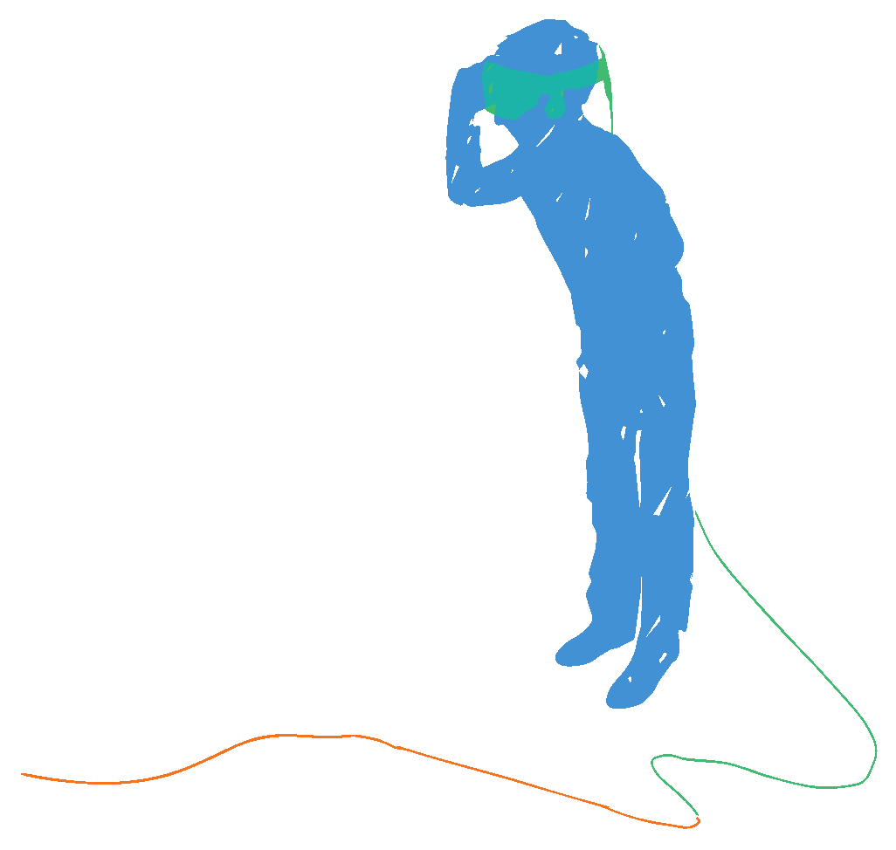
Resources
SimConnect: SSH’s member forum
SimGHOSTS forum
Facebook Groups: Simulation Technician Network; Healthcare Simulation Group; Simulation Online 2020
Additional resources can be found on accompanying document
#IMSH2021
SIMULATION:
BRINGING LEARNING TO LIFE

Slide 22
Contact Us
Devin Stine - dstine89@stanford.edu
Brian Hanlon - bhanlon@alamedahealthsystem.org
Kati Maxkenzie - kmaxkenzie@alamedahealthsystem.org
Lauren O’Niell - loniell@samuelmerritt.edu
Cynthia Shum - cshum@stanfordchildrens.org
#IMSH2021
SIMULATION:
BRINGING LEARNING TO LIFE

Slide 23
ORGANIZATION
Bringing Processes to Your Center
THANK YOU!
SIMULATION:
BRINGING LEARNING TO LIFE
#IMSH2021

