Slide 1
Real-time objective feedback for infant CPR using a novel new infant manikin
– a pilot study with paediatric nurses in the UK
SIMULATION:
BRINGING LEARNING TO LIFE
#IMSH2021

Slide 2
WELCOME
Dr Anna Abelsson Scientific leader at the Clinical Training Center at Jönköping University, Sweden
Lukasz Szarpak, Assoc Prof. PhD, MBA, Vice Rector for Science and International Cooperation at Maria Sklodowska-Curie Medical Academy in Warsaw, Poland
Rob Morrison, Senior Resuscitation Officer at Darent Valley Hospital, Dartford and Gravesham NHS Trust, UK
Dr Jonathan Smart, Global Product Development Director at Innosonian Europe, UK (Conflict of interest)
SIMULATION:
BRINGING LEARNING TO LIFE
#IMSH2021

Slide 3
Hypothesis/Research Question
The hypothesis for this pilot study was to investigate whether it is possible to identify components of infant CPR that improve with practice (using objective and visual feedback).
The objective was to investigate which of the components of infant CPR improve with practice with objective feedback from an infant manikin.
Cardiac arrest in infants is rare but is associated with an overall mortality of up to 90%.
The majority of infants suffering from cardiac arrest have a poor chance of survival compared with older children. Providing good quality chest compressions with correct ventilation technique is essential during infant CPR but has been reported to be challenging to achieve in practice.
Previous studies have found that frequent use of real time feedback in training can improve infant CPR performance. CPR feedback devices are recommended during CPR training to help improve skills.
SIMULATION: BRINGING LEARNING TO LIFE
#IMSH2021

Slide 4
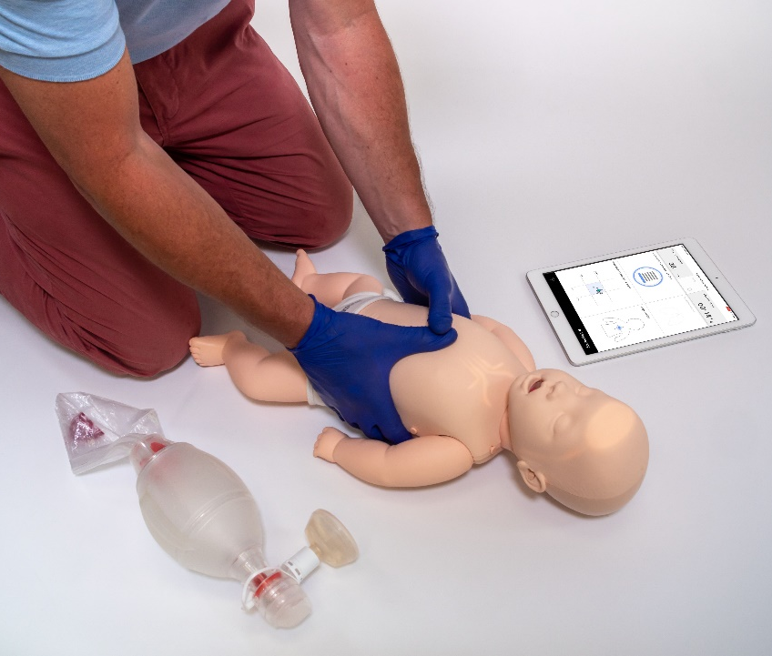
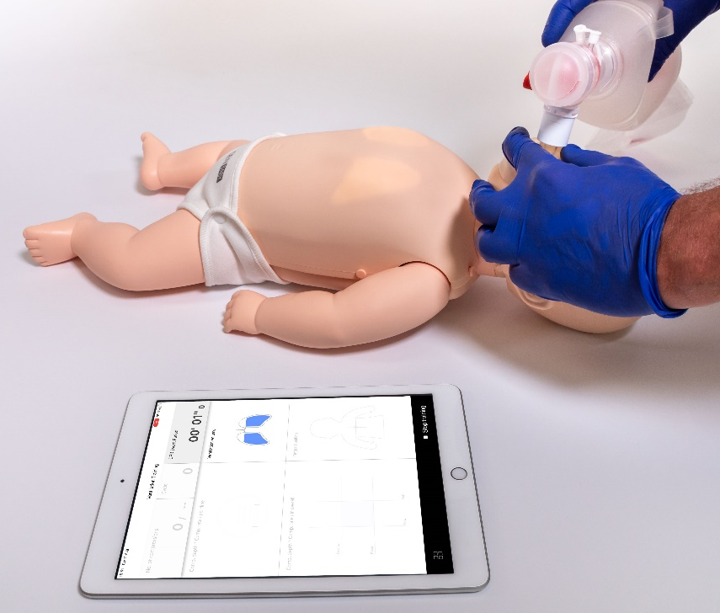
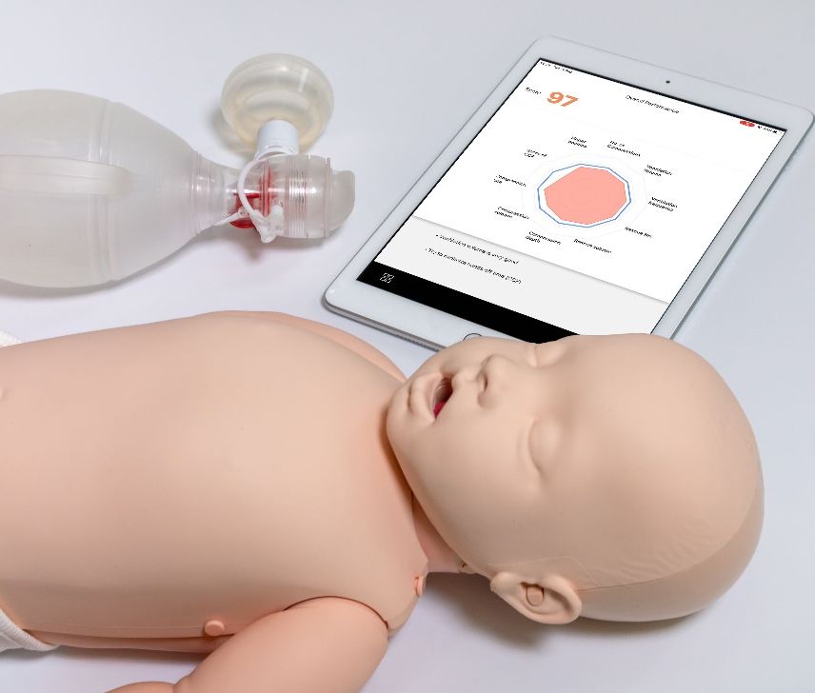
Methods
Visual (lights) and objective real-time feedback (compressions and ventilations) from the infant manikin – as used by the paediatric nurses in Stage 2 of the study. Feedback switched off in Stage 1 and Stage 3. Objective debrief after Stage 2 and Stage 3.
SIMULATION: BRINGING LEARNING TO LIFE
#IMSH2021

Slide 5
Results
SIMULATION:
BRINGING LEARNING TO LIFE
#IMSH2021

Slide 6
Conclusion
Continual quality assurance of CPR performance during training using real time objective feedback via visual and numeric means, together with repetitive practical manikin training, enhances the quality of infant CPR.
The results show guided and free practice with visual feedback (which is easy and quickly understood by the student) when using the infant CPR training manikin helped improve the overall CPR quality performance together with the important component parts of infant CPR technique (i.e correct compression depth, rate, release and correct ventilation volume etc).
These key components of the ERC Paediatric CPR guidelines, when performed correctly, ensure high-quality infant CPR and are essential for maintaining vital organ perfusion.
Infant CPR is difficult to perform within the correct parameters, even for highly skilled providers, so training manikins that help improve and optimize performance and are easy to understand and use should be employed where possible and relevant. These results are consistent with this statement.
Furthermore, the questionnaire results suggest the new infant manikin is easy to understand and use.
SIMULATION:
BRINGING LEARNING TO LIFE
#IMSH2021

Slide 7
QUESTIONS?
#IMSH2021
SIMULATION:
BRINGING LEARNING TO LIFE

Slide 8
Real-time objective feedback for infant CPR using a novel new infant manikin
– a pilot study with paediatric nurses in the UK
THANK YOU!
SIMULATION:
BRINGING LEARNING TO LIFE
#IMSH2021

